Slide 1
Lecture No. 37 Polymers
At the end of this lecture, students will be able to:
Explain the various types of classification of polymers
Identify a polymer on the basis of its physical properties and structural characteristics
Explain the different types of isomerism occurring in polymers
Differentiate between homopolymers and copolymers

Slide 2
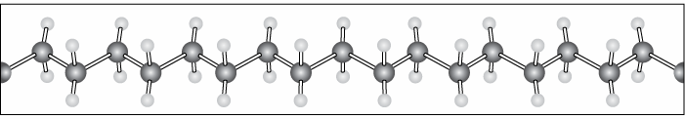
Polymers - Introduction
Polymer: A polymer is defined as a macromolecule formed by the repeated combination of several simple molecules (Monomers) through covalent bonds”
Molecular weight(10⁴ to 10⁷)
Example- Polyethylene, nylon, PVC, Teflon, polyester, bakelite, etc
http://www.e13.physik.tu-muenchen.de/Muellerb/Uebung/chapter01.pdf

Slide 3
Polymers - Introduction
What is a Monomer ?
Small molecules of low molecular weight, which combine to give a polymer, are called monomers
Polymerization:
Polymerization defined as “the chemical reaction in which monomer is converted into polymer”
Note: Monomer can’t undergo polymerization but requires the presence of a chemical called Initiator(Per oxides) or a reactive functional group
(-0H, -NH, -COOH, -SH)
Oligomer:
Short polymer chain

Slide 4
Polymers - Introduction
Functionality of polymer:
The total number of functional groups or bonding sites present in a monomer molecule is called the functionality of the monomer
Degree of polymerization:
The number of monomers used in the process is called degree of polymerization.

Slide 5
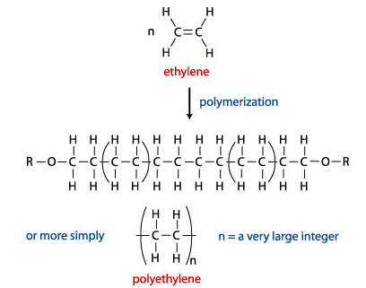
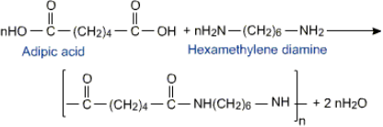

Slide 6
Classification Polymer
Basis of Classification Polymer Type
Origin - Natural, Semi synthetic, Synthetic
Thermal Response - Thermoplastic, Thermosetting
Mode of formation - Addition, Condensation
Line structure - Linear, Branched, Cross-linked
Application and Physical Properties - Rubber, Plastic, Fibers
Tacticity - Isotactic, Syndiotactic, Atactic
Crystallinity - Non crystalline(amorphous), Semi-crystalline, Crystalline
Polarity - Polar, Non polar
Chain - Hetero, Homo-chain

Slide 7

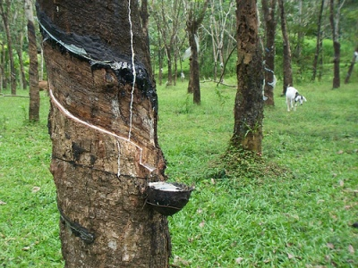
Classification of polymers
Based on their origin polymer can be classified into
-Natural and Synthetic polymers
Natural polymers-are those which obtained from natural sources such as plants and animal
Example-Cellulose, Starch, Protein, Cotton, Silk, Wool, Glycogen, etc.
Synthetic polymers- are those which are synthesized from simple molecule
Example-Polyethylene, polyester, Teflon, PVC, Nylon, etc.

Slide 8
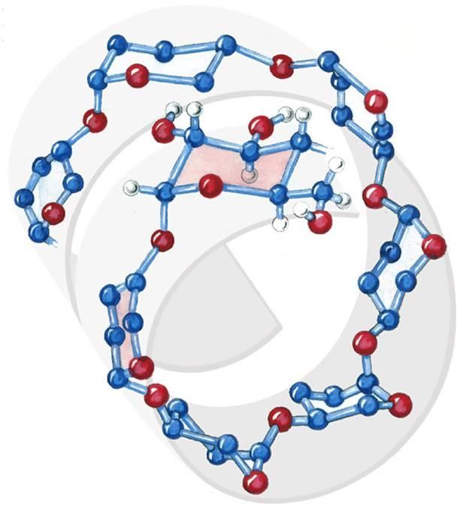
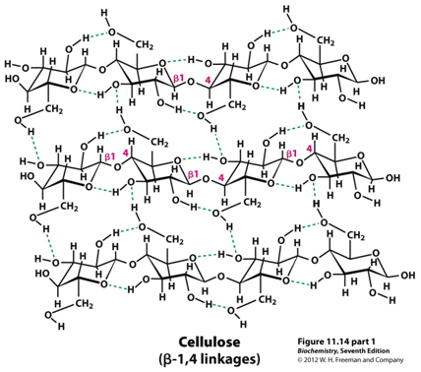
Natural Polymers
Cellulose: Polymer of β-D-glucose
Starch: Polymer of α-D-glucose
oregonstate.edu
www.rsc.org

Slide 9
Synthetic polymers
In the late 1830s, Charles Goodyear succeeded in producing a useful form of natural rubber through a process known as "vulcanization"
Some 40 years later, Celluloid (a hard plastic formed from nitrocellulose) was successfully commercialized
Progress in polymer science was slow until the 1930s, when nylon was developed, and was followed by materials such as vinyl, neoprene and polystyrene
http://www.e13.physik.tu-muenchen.de/Muellerb/Uebung/chapter01.pdf

Slide 10
Physical Properties
Thermoplastic polymer:
Polymer that softens when heated and hardens when cooled.
Can be shaped or moulded. Usually linear or branched.
Partly crystalline and partly amorphous.
Thermosetting polymer:
Very strong and rigid network polymer obtained due to extensive cross-linking.
Cannot be reshaped once it sets.
Elastomers:
Polymers that can stretch and then revert to its original shape.
Amorphous in nature.
Have twisted, flexible chains that can straighten out on applying tension.
Have a low glass transition temperature.

Slide 11

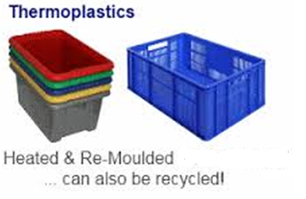
Classification of polymers
Based on their thermal behavior, they can be classified into
–Thermoplastics and Thermo settings
Thermoplastics: The polymer which becomes soft on heating and hard on cooling are called Thermoplatsics
Examples: Polyethylene, Teflon, Plexiglas, PVC, etc.

Slide 12
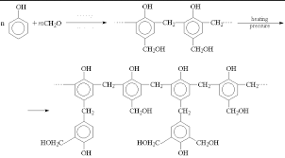
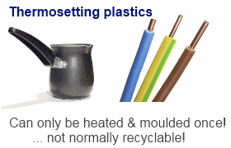
Classification of polymers
Thermosettings: The polymers which undergo chemical changes and cross likings on heating and become permanently hard, rigid and infusible on cooling are called Thermo settings
Examples: Phenol-formaldehyde resins, Urea-formaldehyde resin, epoxy resin,etc.

Slide 13
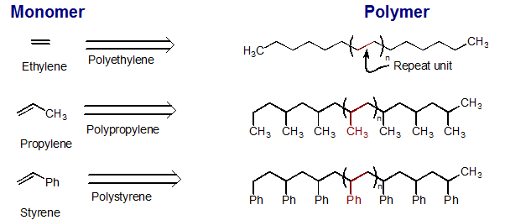
Classification of polymers
Based on their methods of polymerization, they can be classifieds into
–Addition and condensation polymers.
Addition polymers(Chain growth polymerization):
Polymers which are formed by addition of monomers (same or different )to each other without elimination of by products are called addition polymers
Examples: PVC, polystyrene, Teflon, polyethylene, etc.

Slide 14
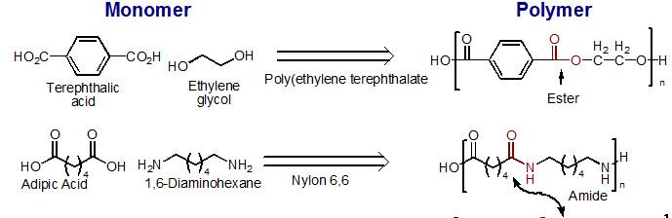
Classification of polymers
Condensation polymers(step growth polymerization):
The polymers which are formed by intermolecular condensation reaction through functional groups of monomers with continuous elimination of by products are called condensation polymers
Examples: Nylons, polyesters, phenol-formaldehyde resin, etc.

Slide 15
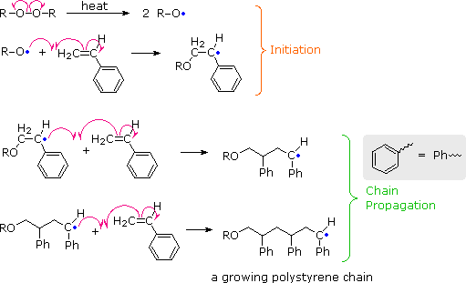
Mechanism of addition polymerization of ethylene
Free radical addition polymerization takes place in three distinct steps
i)Initiation ii) Propagation iii) Termination

Slide 16

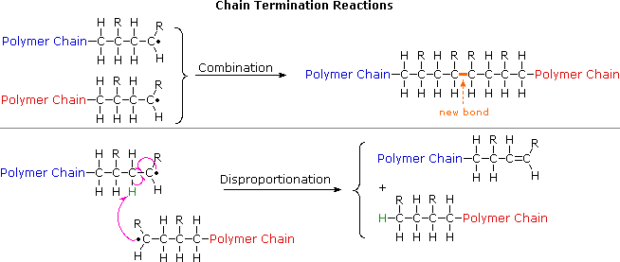
Mechanism of addition polymerization
R =

Slide 17
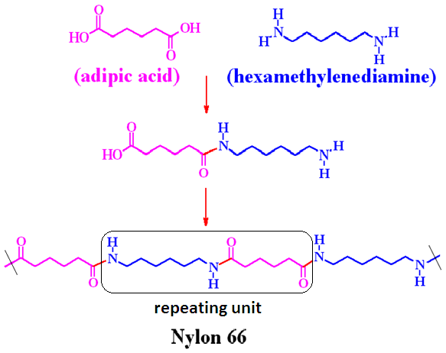
Condensation polymers
-H₂O

Slide 18
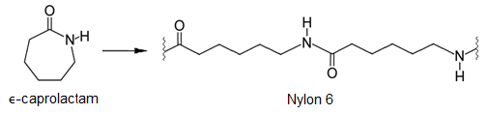
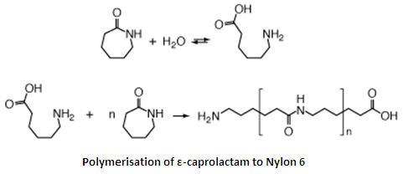
Method of Synthesis
www.mn-net.com

Slide 19
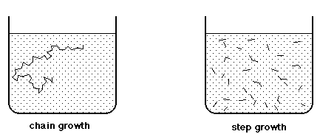
Method of Synthesis

Slide 20
Difference between Addition polymerization and Condensation polymerization
Addition polymerization | Condensation polymerization
Presence of double bond | Reactive functional group
No by product | Elimination of small molecule
Usually thermoplastic | usually thermosetting polymer
Chain growth is at one active centre | Chain growth will be on both sides
Initiator required | No initiator required
Chains not active after termination | Ends remain active (no termination)
PVC, Polyethylene, etc | Bakelite, nylon, etc

Slide 21
Summary
Polymers and their classification
Origin - Natural, Semi synthetic, Synthetic
Thermal Response - Thermoplastic, Thermosetting
Mode of formation - Addition, Condensation
Polymers which are formed by addition of monomers to each other without elimination of by products are called addition polymers
Polymers which are formed by intermolecular condensation reaction through functional groups of monomers with continuous elimination of by products are called condensation polymers

